Slide 1
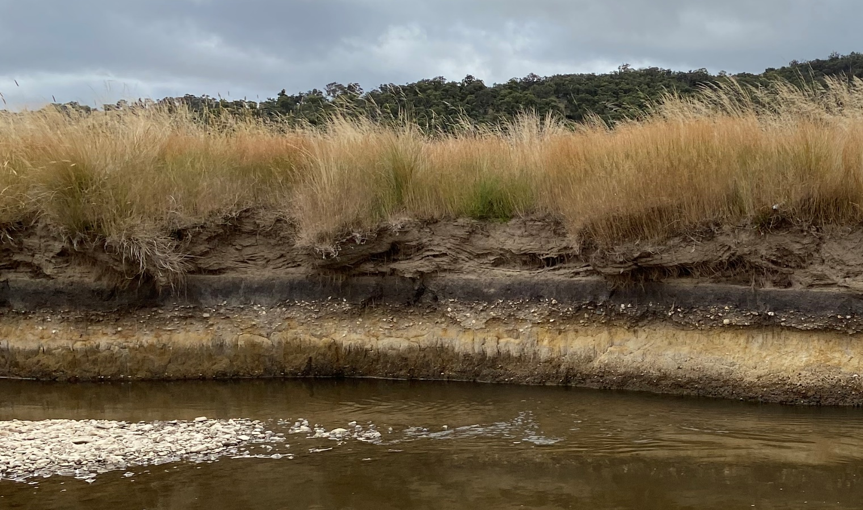
Nature-based Solutions

Slide 2
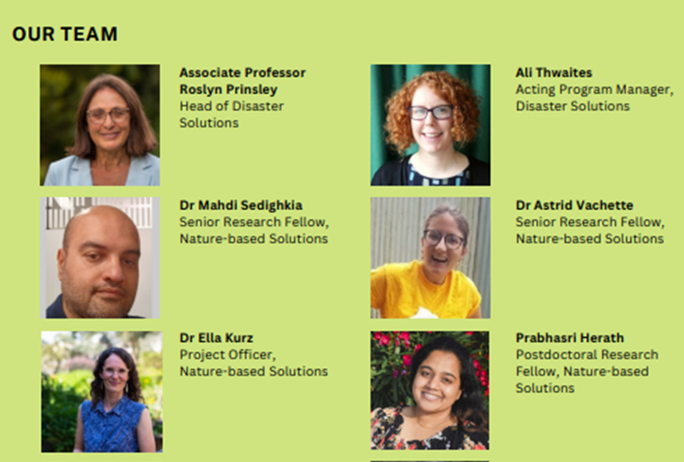
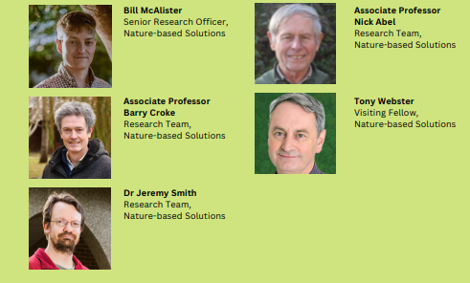
Partnering wiTH communities to identify nature-based solutions for flood resilience IN THE BREMER CATCHMENT
  Astrid Vachette & Bill McAlister

Slide 3
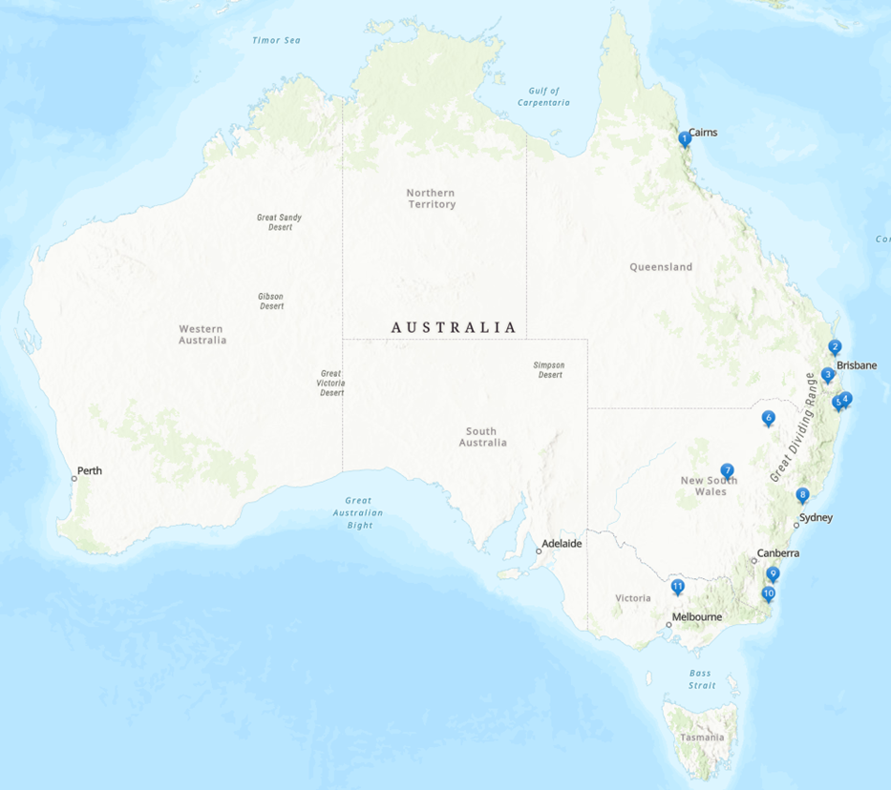
Community project partners and proposed locations of catchment studies

Slide 4
A multidisciplinary project
Community Engagement
Hydrological modeling
Ecological analyses
Social sciences
Institutional analyses
Economic analysis

Slide 5
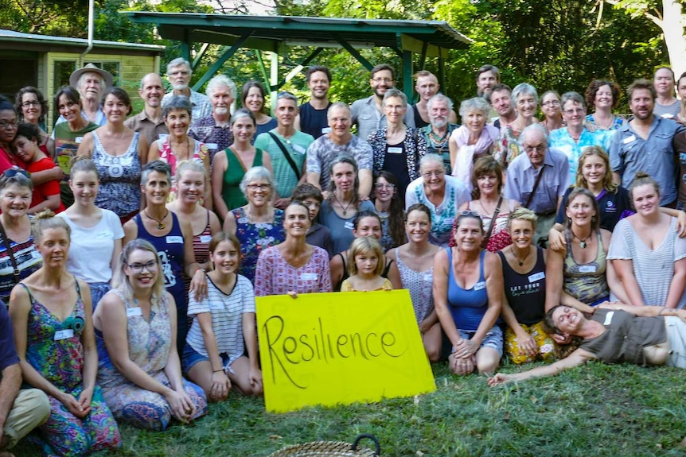
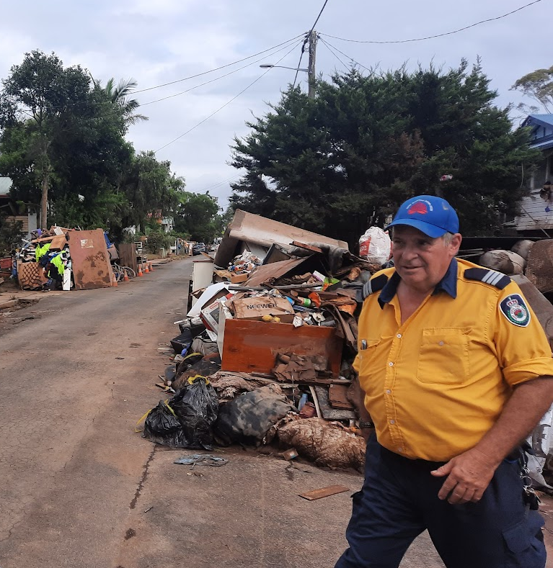
For flood resilience

Slide 6
Nature-based Solutions

Slide 7
Nature-based Solutions
What do you understand by Nature-based Solutions?
What are local examples of Nature-based Solutions that you are aware of?

Slide 8
Nature-based Solutions

Slide 9
Nature-based Solutions
Nature-based solutions are actions to protect, conserve, restore, sustainably use and manage natural or modified terrestrial, freshwater, coastal and marine ecosystems, which address social, economic and environmental challenges effectively and adaptively, while simultaneously providing human well-being, ecosystem services and resilience and biodiversity benefits.
United Nations Environment Assembly

Slide 10
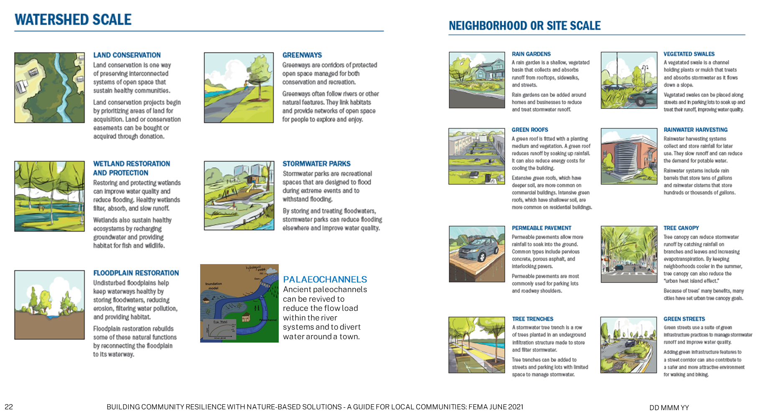
Examples of Nature-based Solutions
Image adapted from Federal Emergency Management Agency (FEMA)

Slide 11
Nature-based Solutions

Slide 12
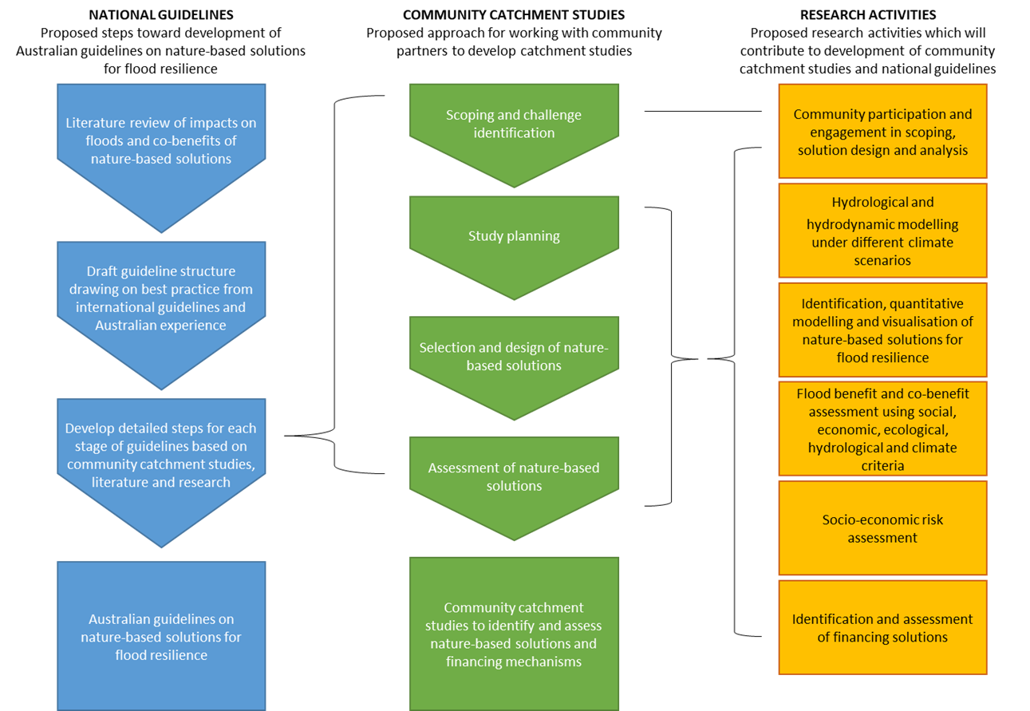
What is our approach?
Integration of research activities with guideline development and community catchment studies.

Slide 13
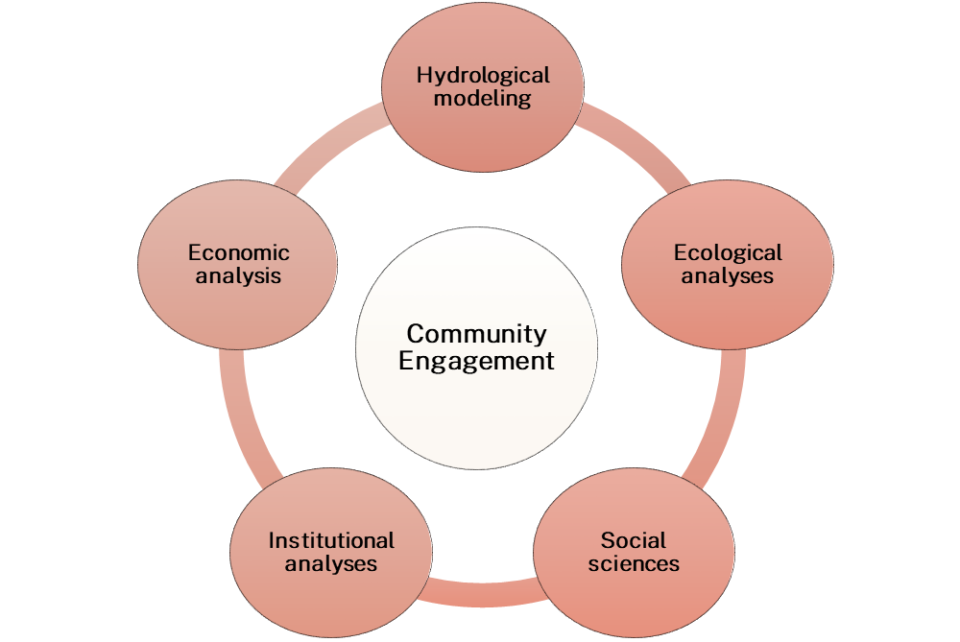

Community engagement
Community Engagement seeks to better engage the community to achieve long-term and sustainable outcomes, processes, relationships, discourse, decision-making, or implementation.
(definition from Penn State's Center for Economic and Community Development)
Source: International Association of Public Participation

Slide 14
Nature-based Solutions
What content do you feel would be necessary for guidelines to Nature-based Solutions to flooding?
Where and how would community need to be engaged in the design of Nature-based Solutions to flooding?

